Slide 1











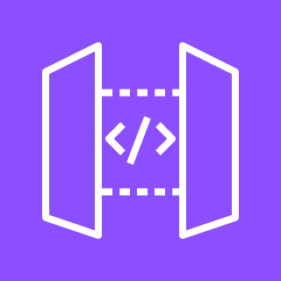

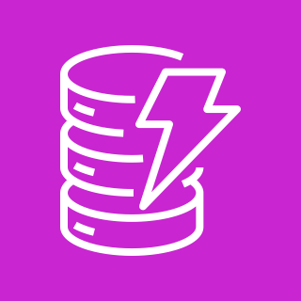

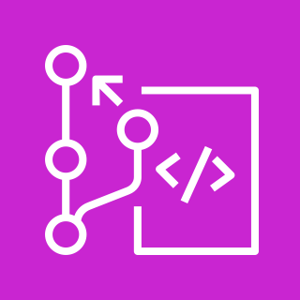
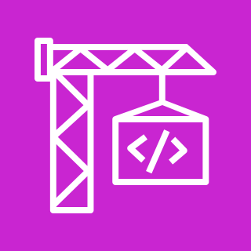




DME – AWS Cloud Native Architecture
AWS Region
SNS
users
Amazon VPC
Private subnet
Step Functions Workflow
Managed Amazon EKS Cluster
Fargate
Microservice A
Microservice B
Async Workflow A
Async Workflow B
service
service
API Gateway
pods
pods
Dynamo DB
10
dev team
AWS CodePipeline
AWS CodeCommit
AWS CodeBuild
Amazon ECR
X-Ray
CloudWatch
Notes:
A developer initiates an activity in AWS CI/CD pipeline such as push code changes. These activities create Amazon CloudWatch events.
An Amazon EventBridge event rule detects the CloudWatch events and sends the event data to an Amazon Kinesis Firehose Delivery Stream. One event rule per event source.
An event rule is also created to capture event data from Amazon CloudWatch Synthetics Canary if customer has set up the canary – only needed for MTTR.
The Firehose uses a Lambda function for data transformation. It extracts relevant data and sends it to an Amazon S3 bucket.
An Amazon Athena database queries the S3 data and returns the query result to an Amazon QuickSight.
An Amazon QuickSight obtains the query result and builds dashboard displays for the management team.

Slide 2
AWS Services References
EKS
Fargate
API Gateway
CloudWatch
DynamoDB
X-Ray
Step Functions
SNS

Slide 3
Microservice (Internal) Java Architecture
Spring Boot Microservice
Presentation
DTO
Service
Persistence
Shared Libraries / Core Microservices
Common
Domain Model
Authentication
Data Transfer
Data Management

Slide 4
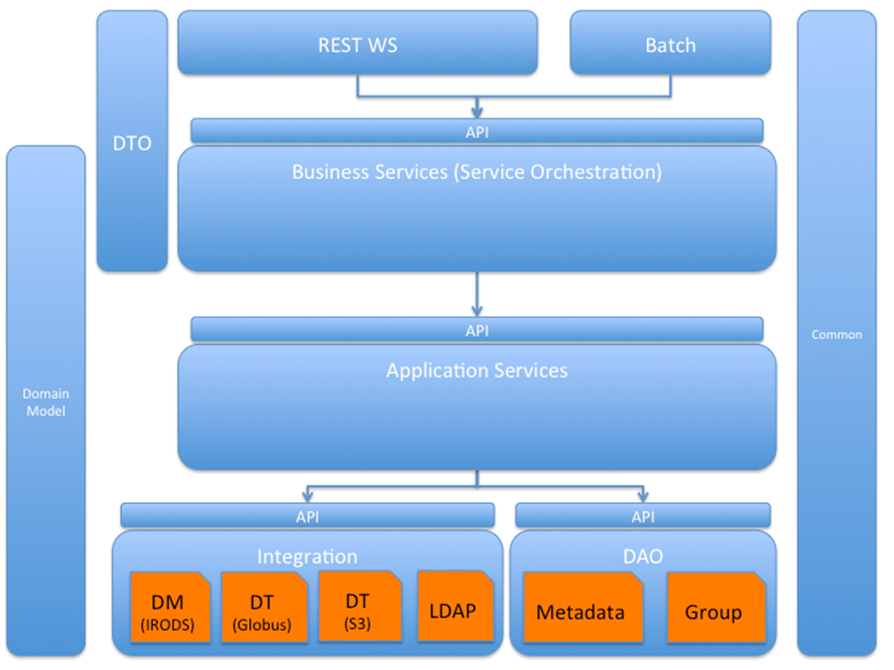

Slide 5
Design Patterns
https://medium.com/capital-one-tech/10-microservices-design-patterns-for-better-architecture-befa810ca44e

